Slide 1
Face Detection using the Viola-Jones method
Davide Rossi
Machine Learning Project, 2018

Slide 2
Introduction
Three major contributions/phases of the algorithm :
Feature extraction and feature evaluation:
Rectangular features are used, with a new image representation their calculation is very fast.
Classification using boosting:
Classifier training and feature selection using a slight variation of a method called AdaBoost.
Multi-scale detection algorithm:
A combination of simple classifiers is very effective

Slide 3

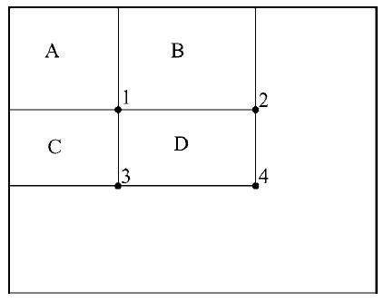
Integral Image
The Integral Image at any point (x, y) in the summed-area table is the sum of all the pixels above and to the left of (x, y), inclusive
It is useful because the sum of every pixel in a rectangular can be obtained only with a sum of 4 pixel of the integral image.
The internal sum of D is
𝐷= 4−3−2+1 in fact :
4−3−2+1= (𝐴+𝐵+𝐶+𝐷) − (𝐴+𝐶)− (𝐴+𝐵)+𝐴=𝐷

Slide 4
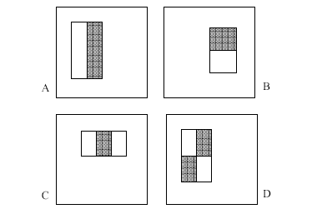
Features
Four basic types.
They are easy to calculate.
The white areas are subtracted from the black ones.
A special representation of the sample called the integral image makes feature extraction faster.
Features are extracted from sub windows of a sample image.
The base size for a sub window is 24 by 24 pixels.
Each of the four feature types are scaled and shifted across all possible combinations
-In a 24 pixel by 24 pixel sub window there are ~160,000 possible features to be calculated.

Slide 5
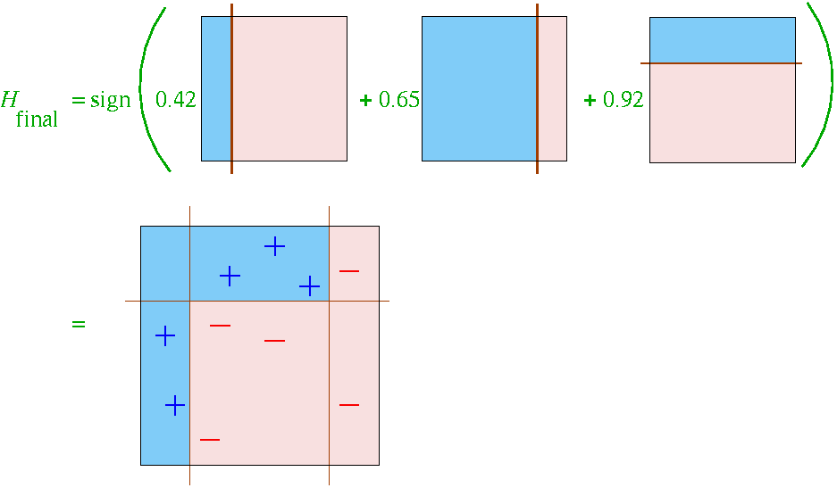
Learning with many Features
We have 160,000 features – how can we learn a classifier with only a few hundred training examples without overfitting?
Learn a single simple classifier
Classify the data
Look at where it makes errors
Reweight the data so that the inputs where we made errors get higher weight in the learning process
Now learn a 2nd simple classifier on the weighted data
Combine the 1st and 2nd classifier and weight the data according to where they make errors
Learn a 3rd classifier on the weighted data
… and so on until we learn T simple classifiers
Final classifier is the combination of all T classifiers
This procedure is called “Boosting” – works very well in practice.

Slide 6
Boosting with Single Feature Perceptrons
Viola-Jones version of Boosting:
“simple” (weak) classifier = single-feature perceptron:
= 1 (if w₁x₁ + w_{d+1} >0)
o(x₁)
= -1 (otherwise)
With K features (e.g., K = 160,000) we have 160,000 different single-feature perceptrons
At each stage of boosting
given reweighted data from previous stage
Train all K (160,000) single-feature perceptrons
Select the single best classifier at this stage
Combine it with the other previously selected classifiers
Reweight the data
Learn all K classifiers again, select the best, combine, reweight
Repeat until you have T classifiers selected
Hugely computationally intensive
Learning K perceptrons T times
E.g., K = 160,000 and T = 1000

Slide 7
How is classifier combining done?
At each stage we select the best classifier on the current iteration and combine it with the set of classifiers learned so far, but how are the classifier combined?
Take the weight*feature for each classifier, sum these up, and compare to a threshold (very simple)
Boosting algorithm automatically provides the appropriate weight for each classifier and the threshold
This version of boosting is known as the AdaBoost algorithm
Cascade of Classifier
Referred here as a degenerate decision tree.
Very fast evaluation.
Quick rejection of sub windows when testing.
Reduction of false positives.
Each node is trained with the false positives of the prior.

Slide 8
Detection in Real Image
Basic classifier operates on 24 x 24 subwindows
Scaling:
Scale the detector (rather than the images)
Features can easily be evaluated at any scale
Scale by factors of 1.25
Location:
Move detector around the image (e.g., 1 pixel increments)
Final Detections:
A real face may result in multiple nearby detections

